Slide 1


Language Learning Application
Hi!
Aluu!
Salut!
Jambo!
Oi!
Supervisor: Mr. Alex Keselman Students: Oneill Panker & Roman Gury

Slide 2
Agenda
01
02
03
04
Problem
&
Solution
Application
Structure
Challenges
Demonstration
2
Notes:
Slide 1: Problem & Solution
Problem: Language learning can often be tedious, repetitive, and lacks engagement. Traditional apps don't adapt dynamically to a learner’s needs or progress, leading to slower improvement.
Solution: GPTalk: A web application designed to provide a gamified, interactive language learning experience. Powered by OpenAI's GPT-4, GPTalk dynamically generates personalized exercises and conversational practice. Users can track their progress through experience points (exp), achievements, and leaderboards.
Slide 2: Main Requirements
Key Requirement 1: Integration with OpenAI’s GPT-4 to generate dynamic content.
Key Requirement 2: User-friendly interface, accessible across devices (desktop, tablet, mobile).
Key Requirement 3: Gamification elements like achievements, exp, and leaderboards to motivate learners.
Key Requirement 4: Fast and cost-effective response generation using GPT-4-mini for scalability.
Slide 3: Solution Description
Frontend: Built using Angular, with PrimeNG and PrimeFlex for responsive design and accessibility.
Backend: Powered by Express.js for handling API requests, including interactions with OpenAI’s GPT-4.
Database: MongoDB stores user data, including progress, achievements, and session history.
Core Features:
Learn Mode: Structured lessons with exercises like fill-in-the-blank, translation, and sentence reordering.
Chat with Me: Simulates real-life conversations, allowing users to practice and receive feedback.
Slide 4: Project Goals
Goal 1: Create a gamified language learning platform that adapts dynamically to the user's progress.
Goal 2: Utilize GPT-4 for generating diverse and engaging content for users at different proficiency levels.
Goal 3: Build an intuitive, accessible interface that supports users of varying technical abilities.
Slide 5: Project Challenges
Challenge 1: Constructing effective prompts for OpenAI to generate structured language exercises.
Solution: Simplified prompts and used additional functions to process API responses into the required exercise format.
Challenge 2: Lack of variety in generated exercises.
Solution: Added random topics to prompts to increase exercise diversity.
Challenge 3: Integration of GPT-4-mini.
Solution: Optimized prompts to work within GPT-4-mini's shorter token limit while maintaining quality.
Slide 6: Conclusion
GPTalk successfully combines modern machine learning technologies with gamified language learning.
Despite challenges, we developed a robust, scalable platform capable of adapting to various user needs.
Future improvements could include adding a dark mode, adding more languages for the interface, and expanding mobile support.

Slide 3
Problem
3

Slide 4
Problem
Language learning can often be tedious, repetitive, and lacking in engagement
Existing applications typically suffer from repetitiveness, and a lack of variety in learning material
Existing solutions tend to be lacking in terms of clear instructions, examples and support for the students
4

Slide 5
Solution
5

Slide 6



Solution
Generates content using the OpenAI API
Provides conversational practice for the user based on their skill level and language of choice
Teaches through gamification
Contains elements like levels, language ranks, achievements
Leaderboards allow users to compare their progress, encouraging competition
User friendly interface both on PC and mobile devices
Minimal amount of navigation needed to access features
Difficulty of generated content matches the user’s skill level
Levels of difficulty are separate for each language being learned
6
Notes:
User friendly interface – 3 click access

Slide 7





Technology Stack
Angular
Express.js
MongoDB
Jest
OpenAI API
For responsive and dynamic UI
Efficient server-side logic
Flexible data storage
Unit testing
Interactive content generation
7

Slide 8
Application Structure
8

Slide 9

Application Architecture
OpenAI API
Send prompts /
Receive responses
Use the
website
Send / Receive
requests
Client
Server
User
Save / Retrieve
data
Database
9

Slide 10

Login and Registration
10

Slide 11
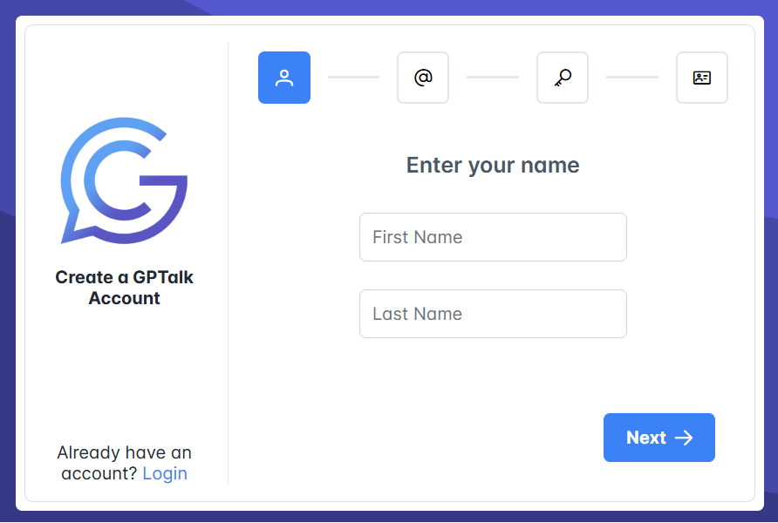
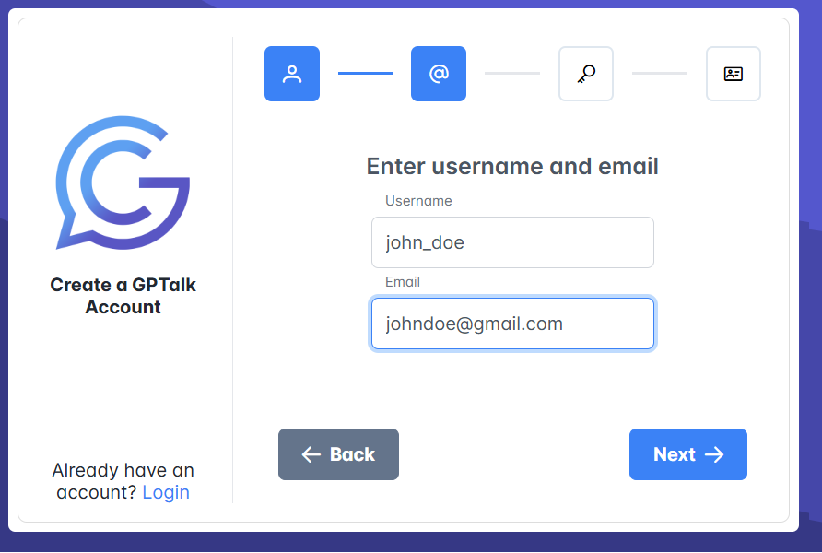
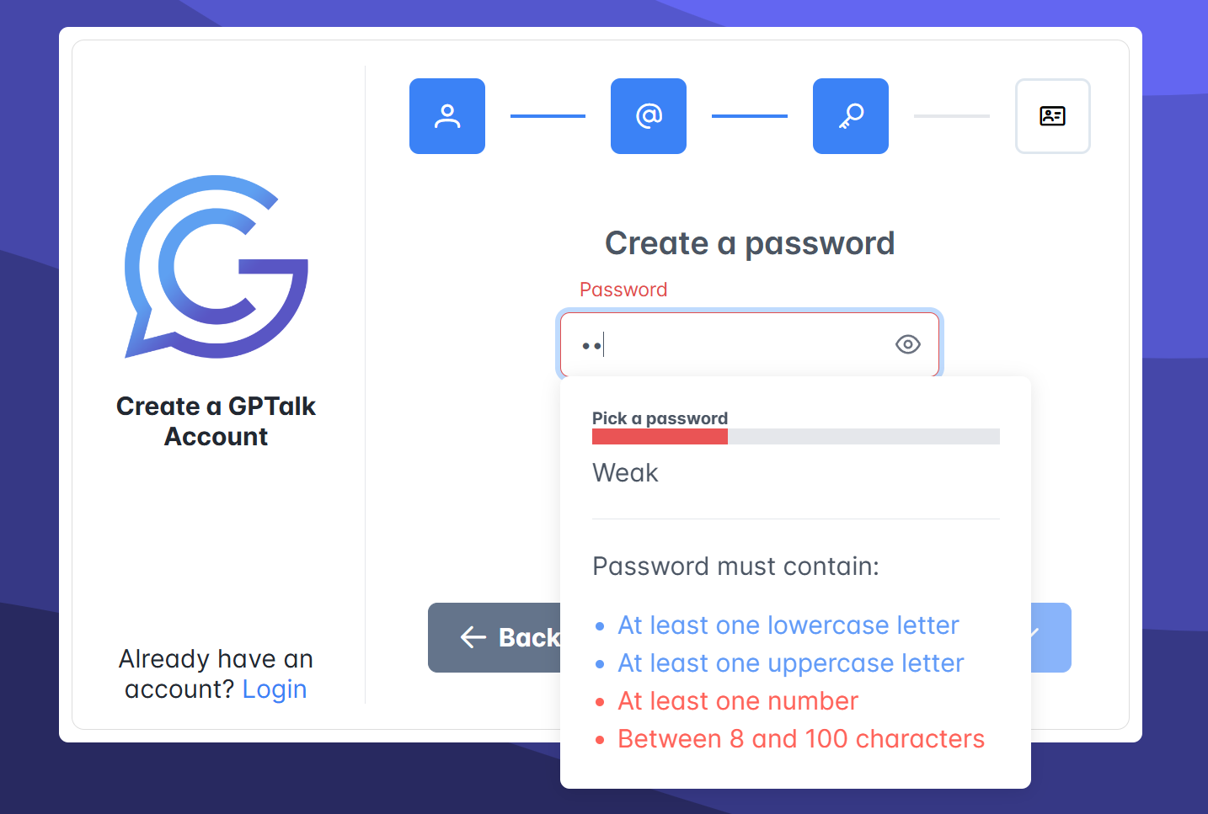
Login and Registration
1
2
3
11

Slide 12
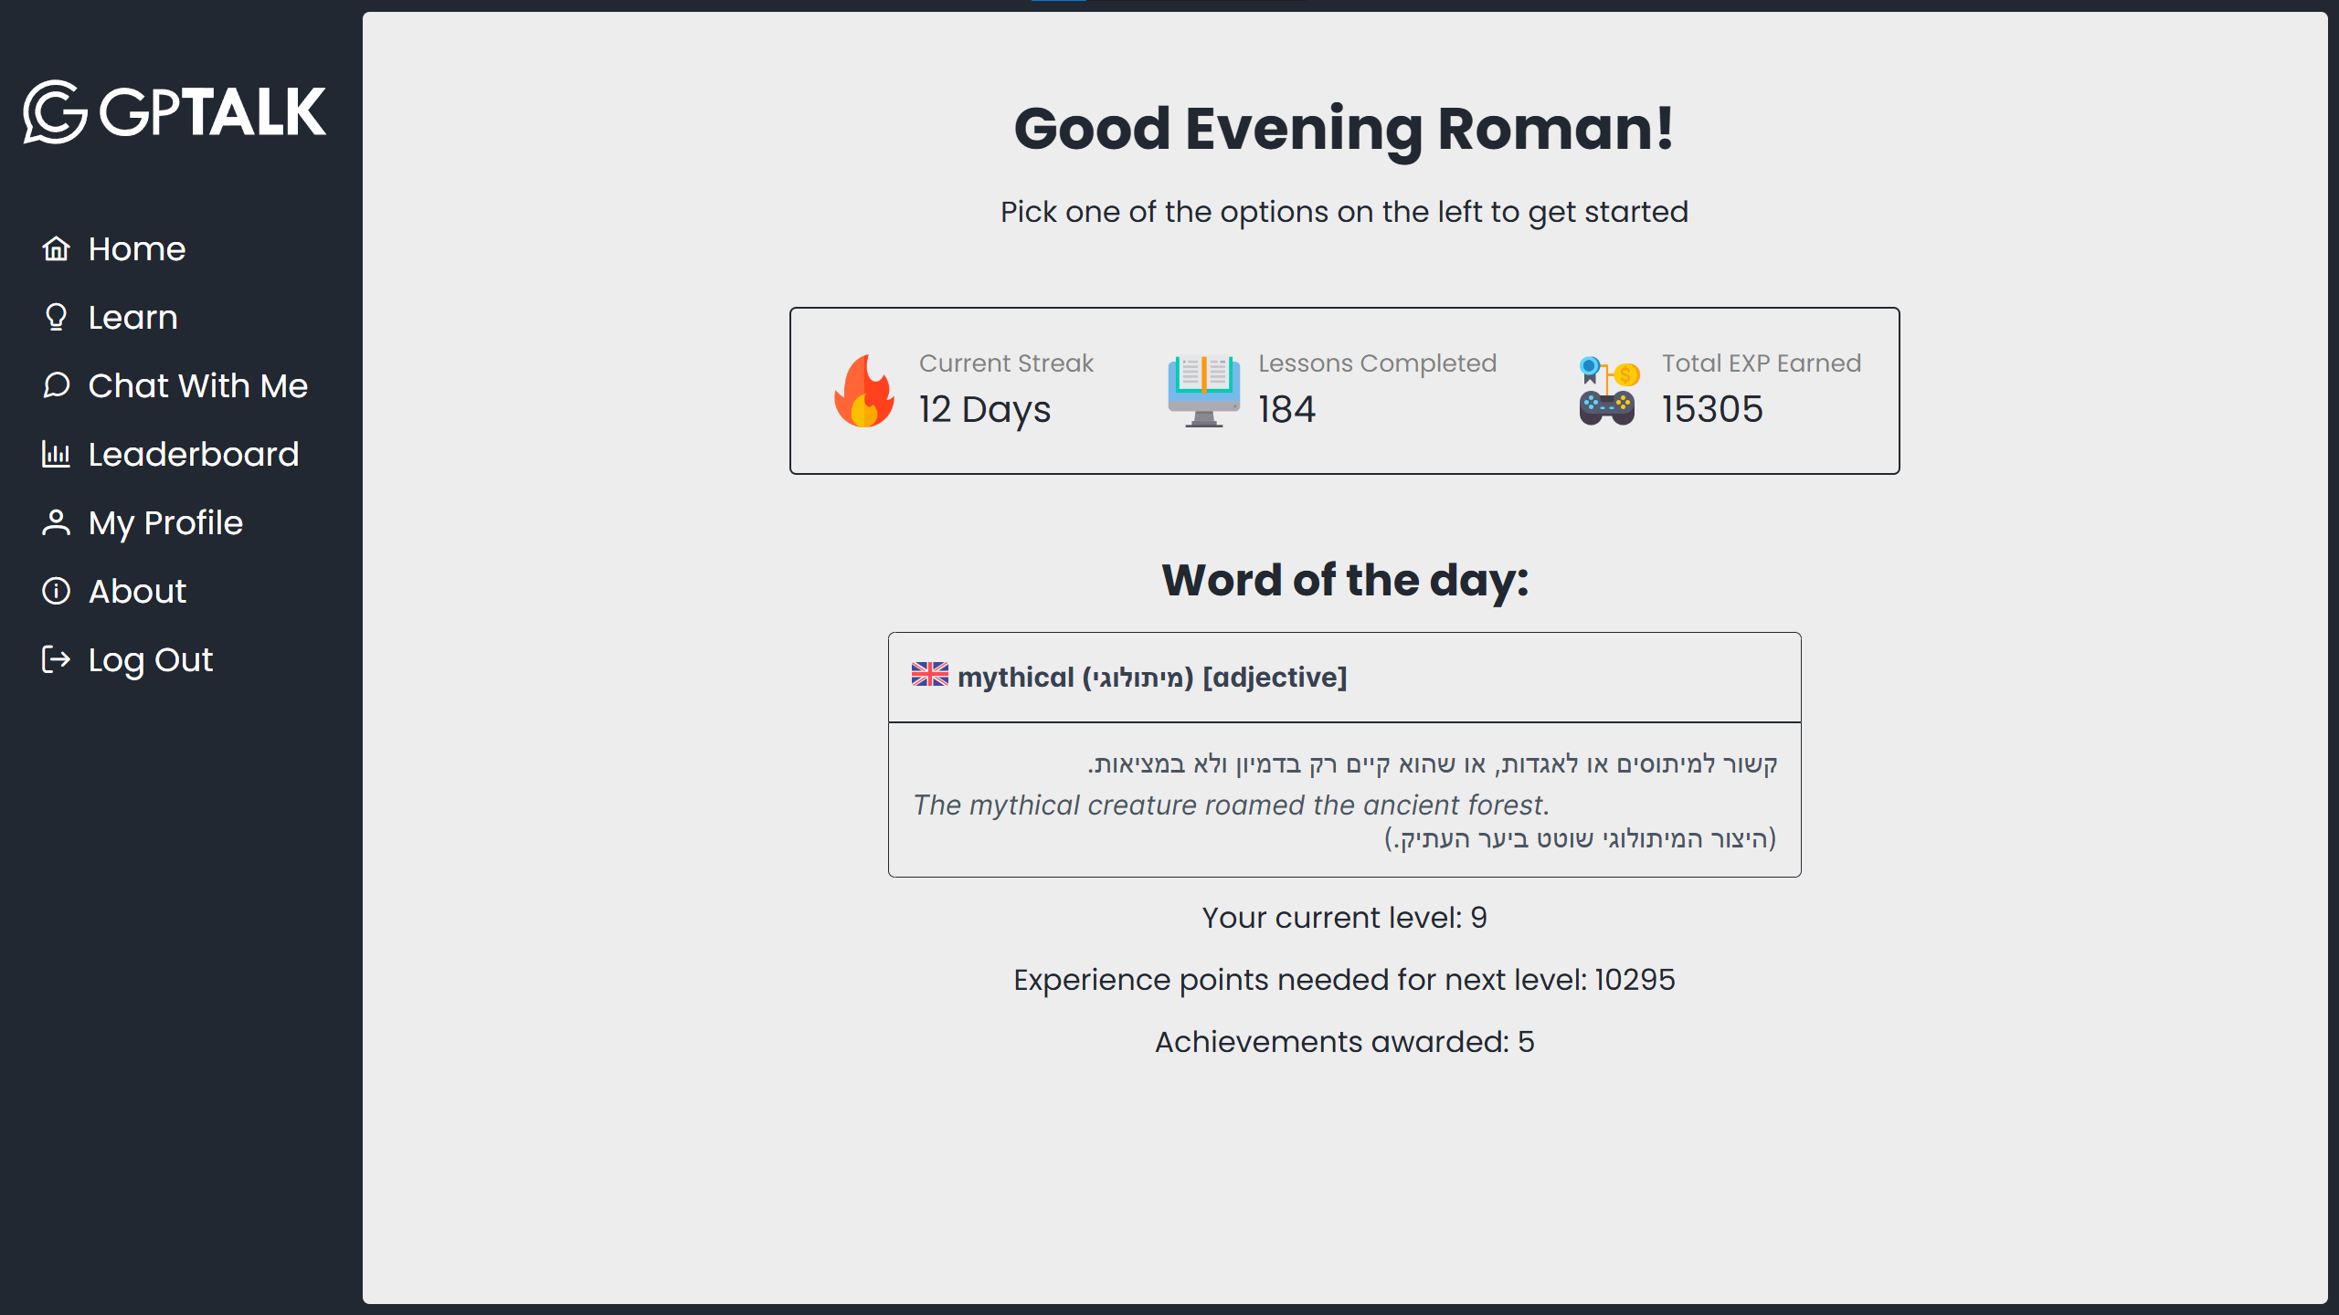
Home Screen
12

Slide 13
Learn
13

Slide 14
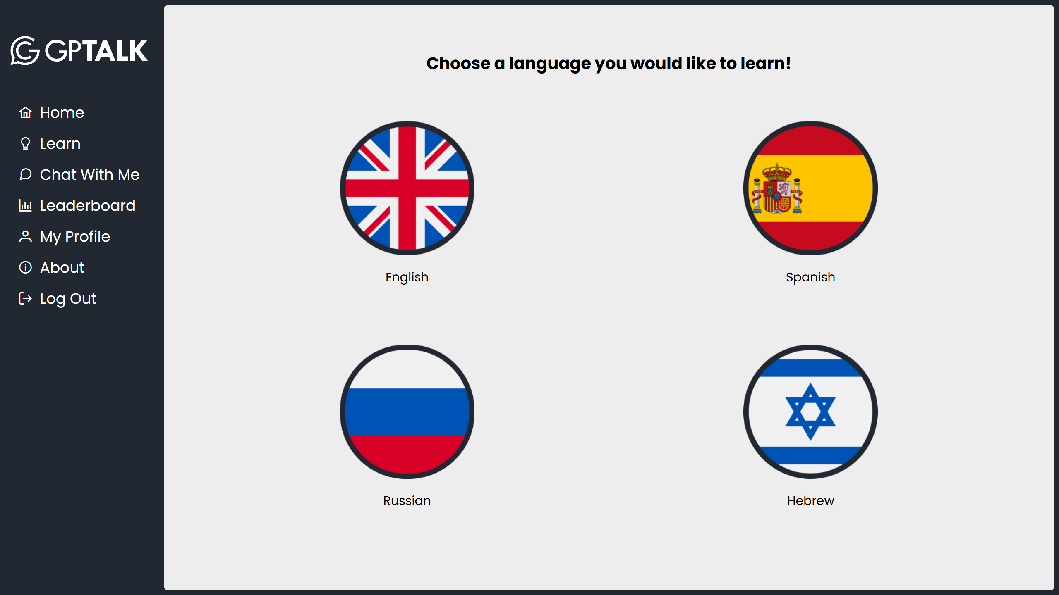
Learn
14

Slide 15
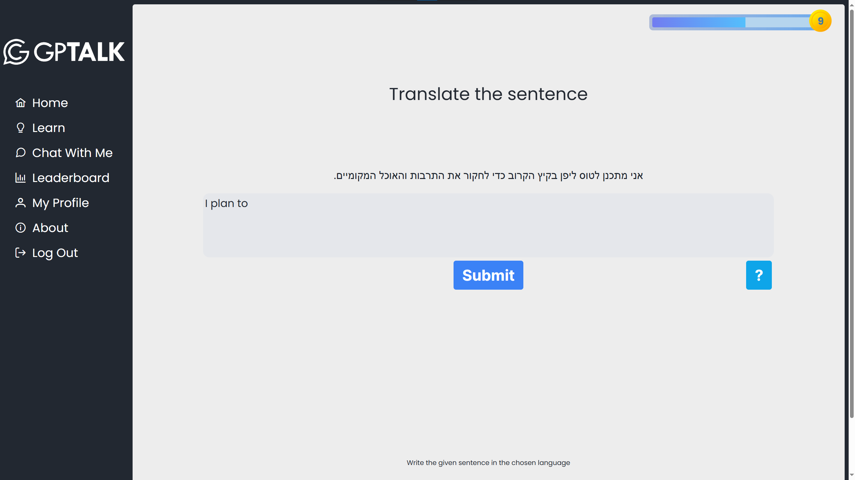


Learn
15

Slide 16
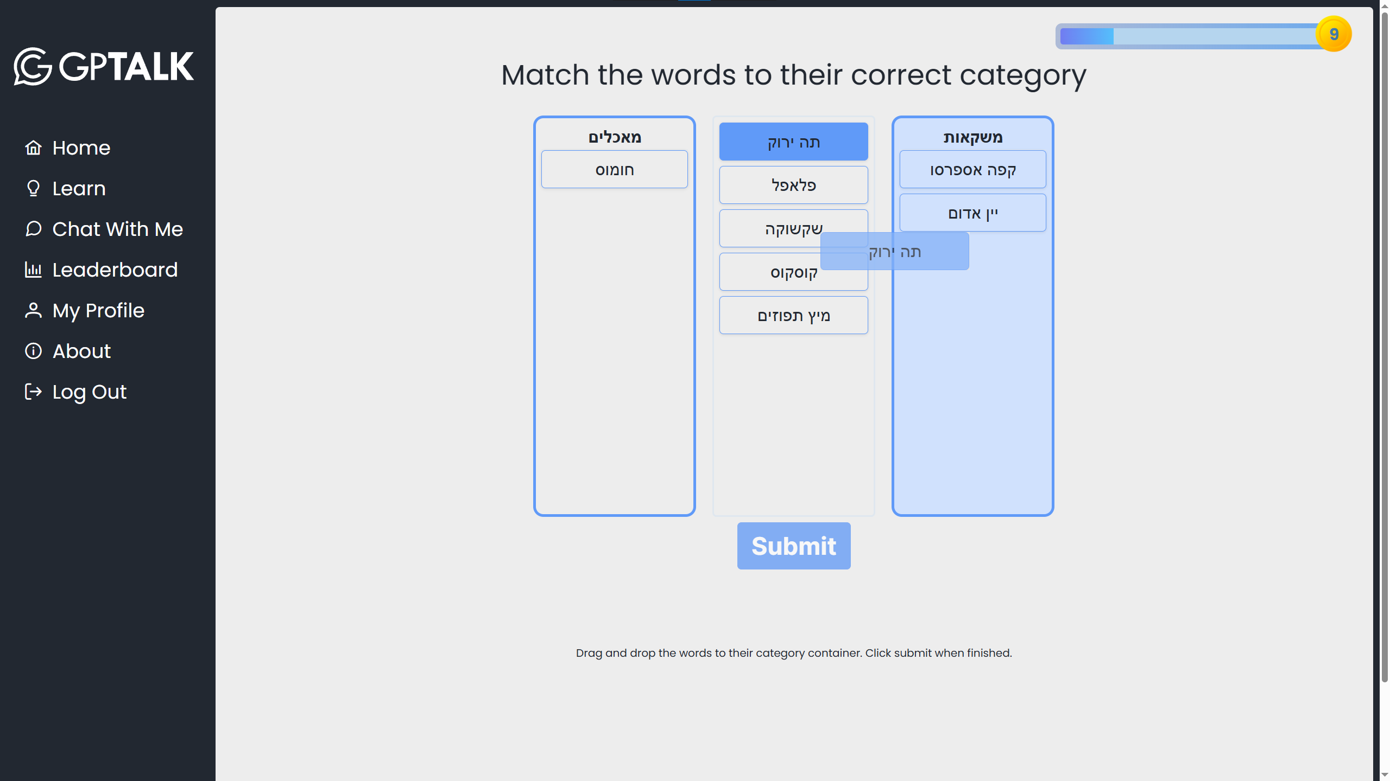
Learn – Match The Category
16

Slide 17
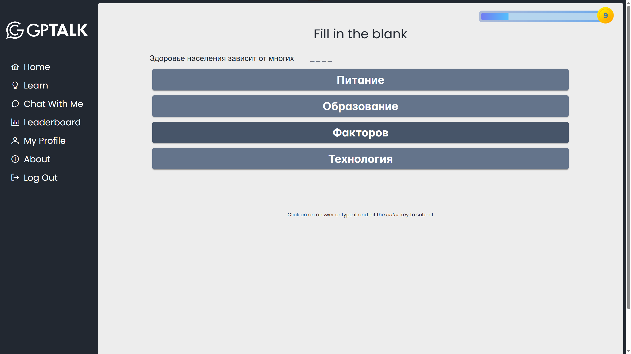
Learn – Fill In The Blank
17

Slide 18
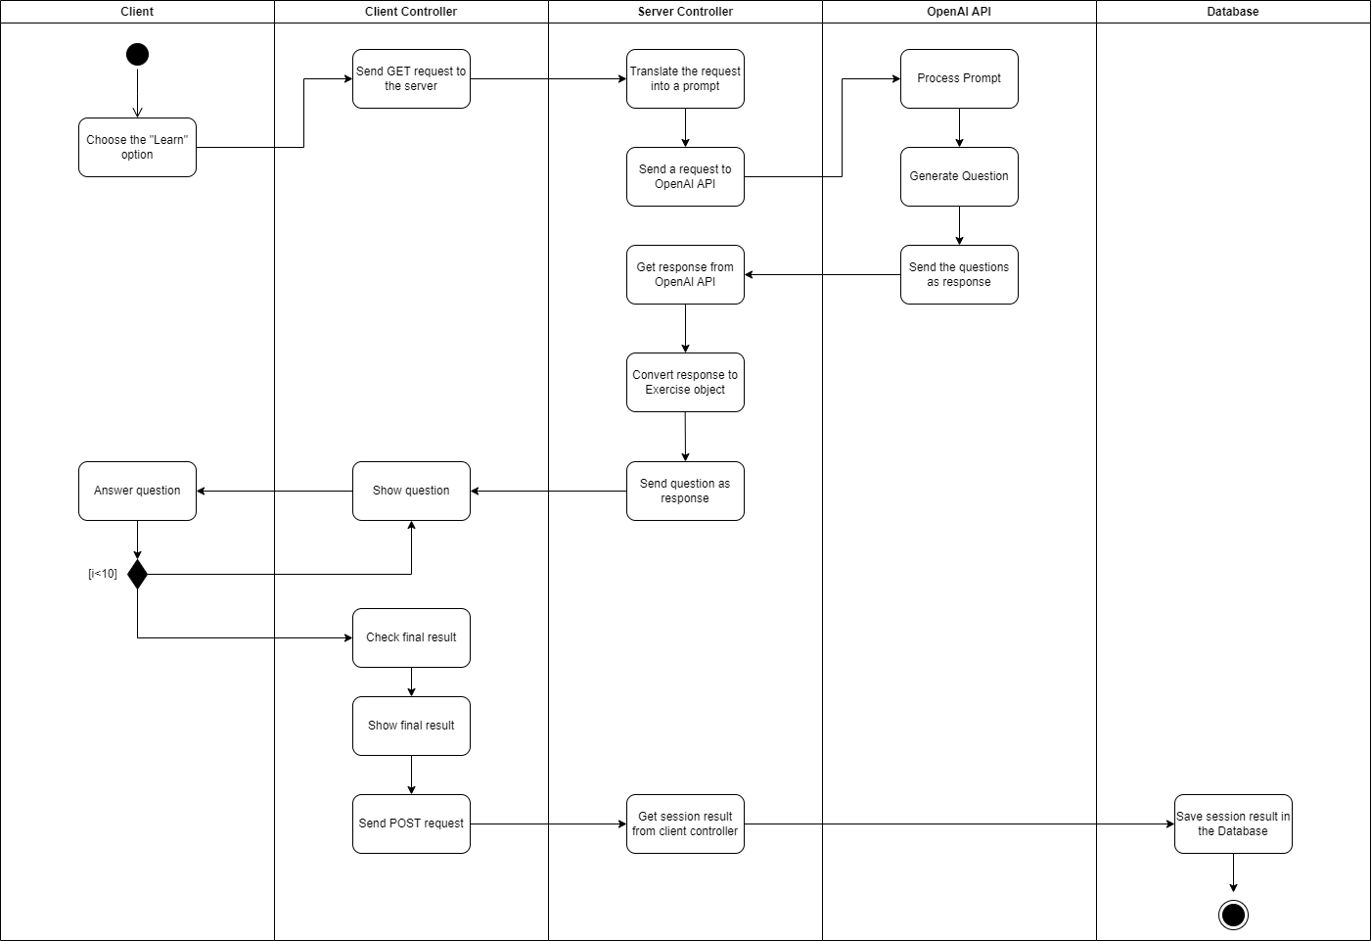
Learn – Activity Diagram
18

Slide 19
Chat With Me
19

Slide 20

Chat With Me
20

Slide 21
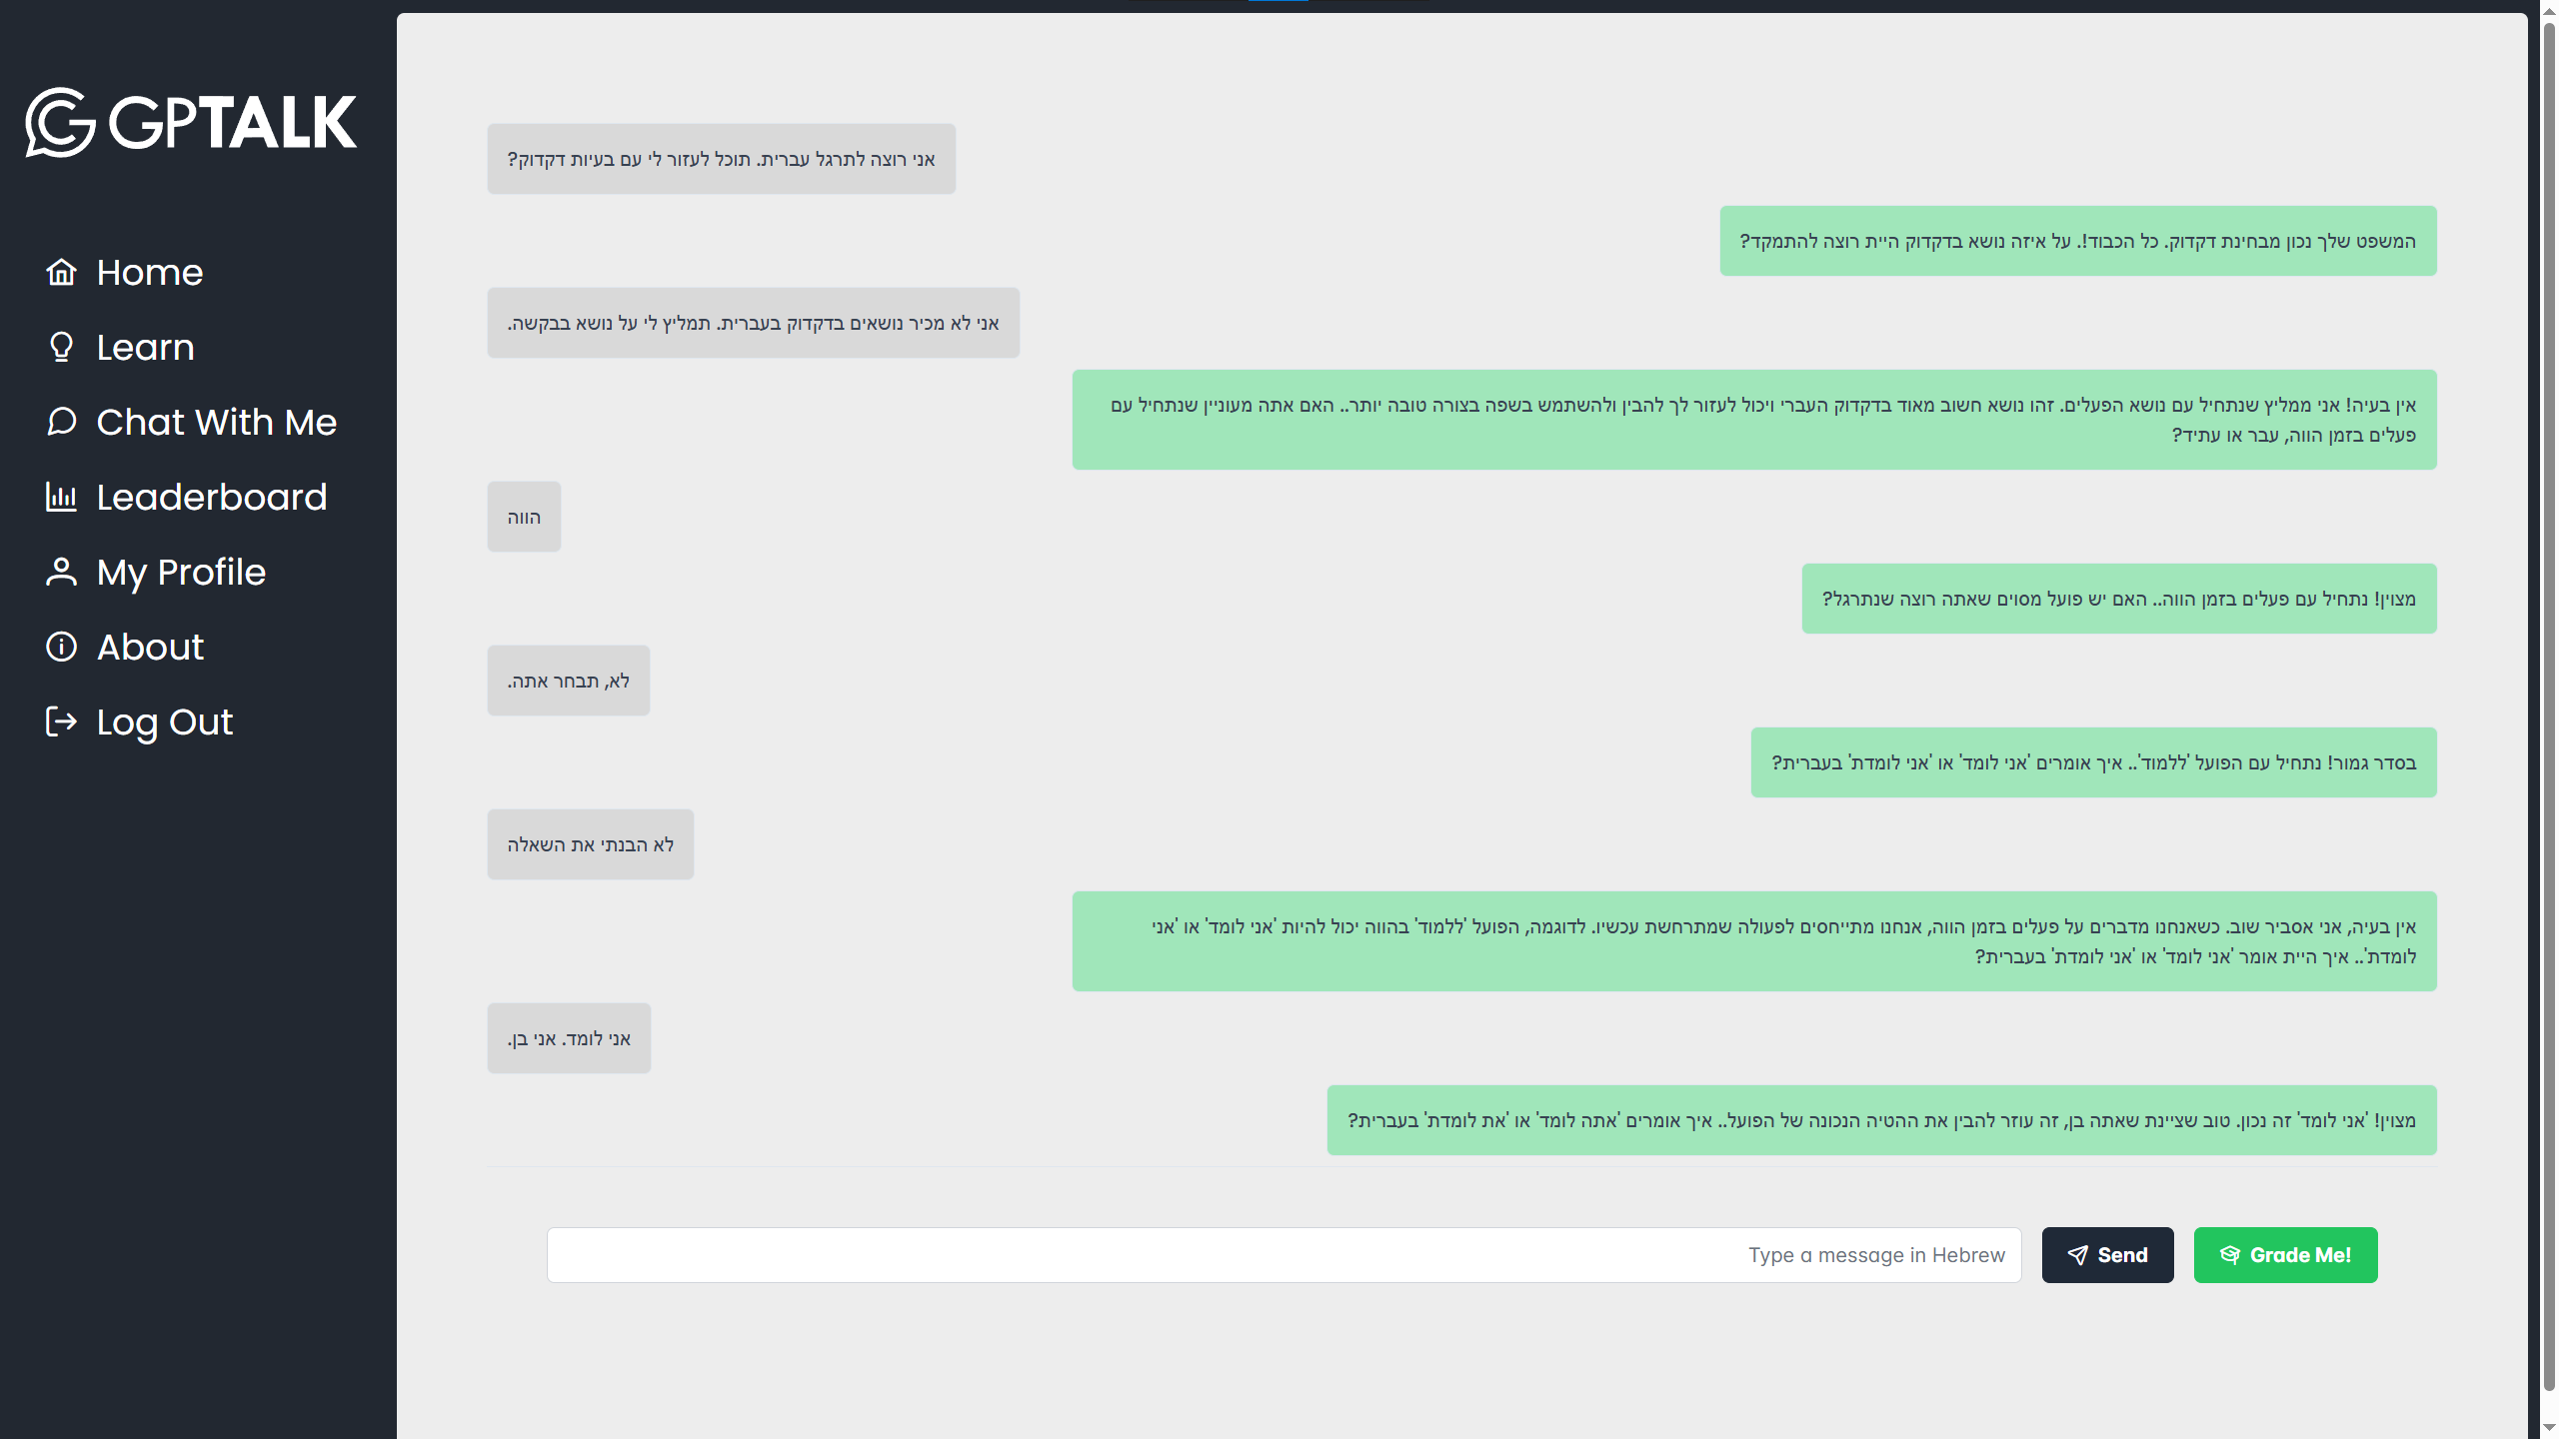
Chat With Me
21

Slide 22
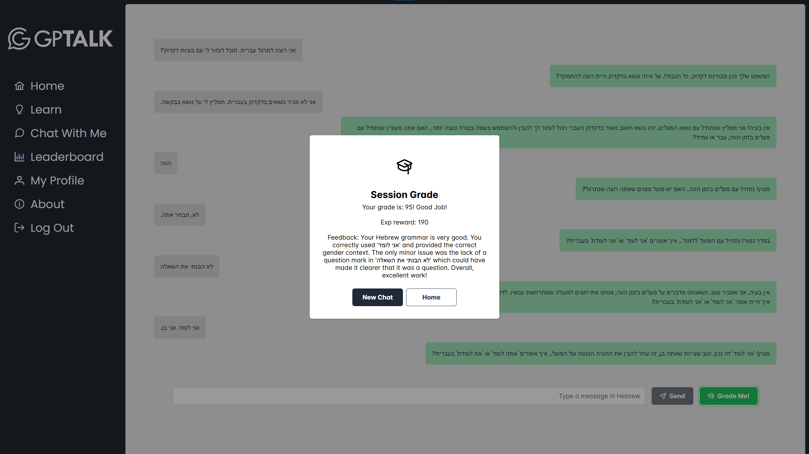
Chat With Me
22

Slide 23
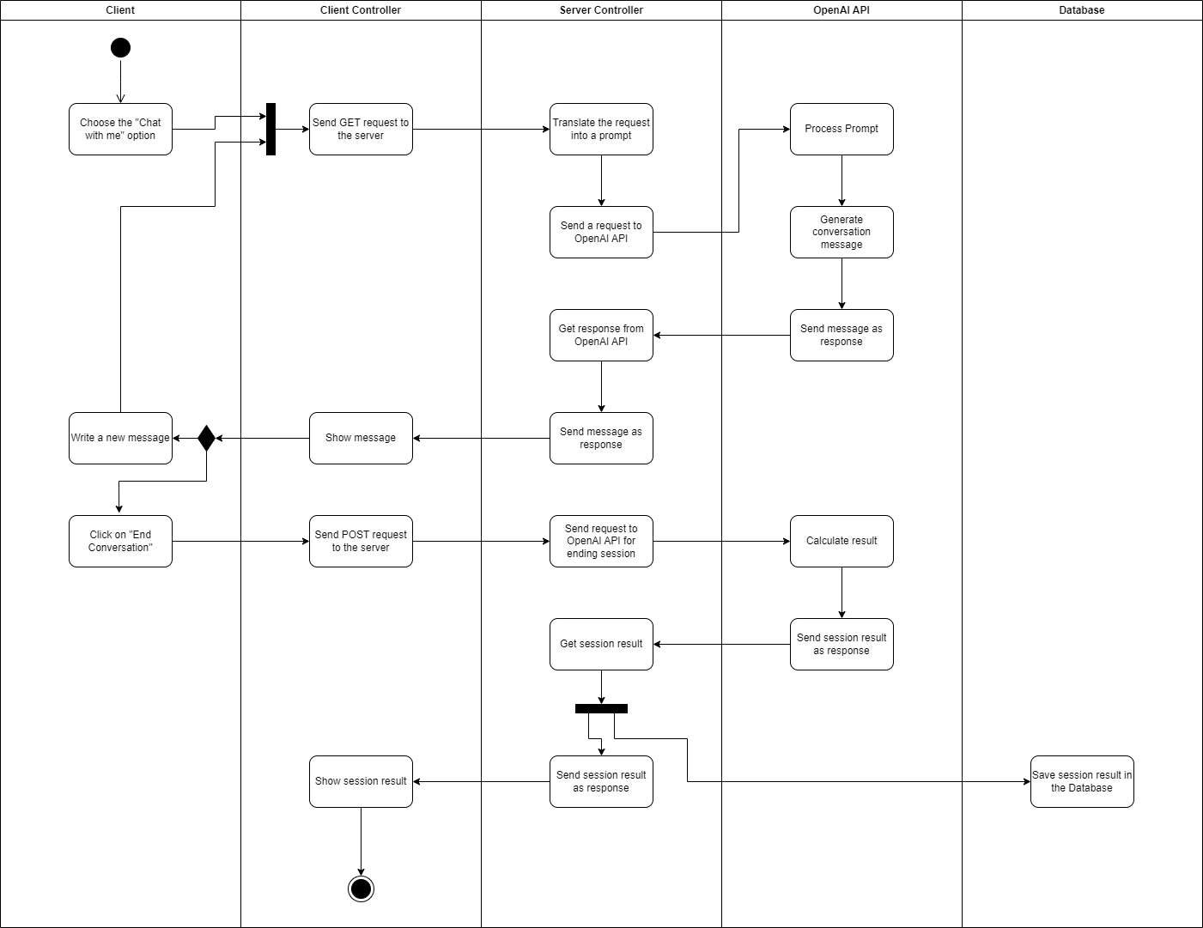
Chat With Me – Activity Diagram
23

Slide 24

Leaderboard
24

Slide 25

Leaderboard
25

Slide 26
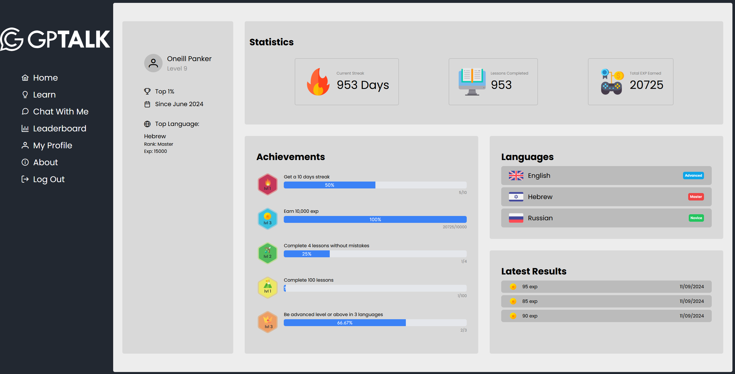
My Profile
26

Slide 27

About
27

Slide 28
Challenges
28

Slide 29

Challenges
Prompt construction
Prompt length
Generated Data Reliability
Result variety
Handling user statistics
29
Notes:
Prompt construction - Constructing the prompts for OpenAI’s API proved to be a challenge: The initial plan was to construct a single detailed prompt for a single lesson by dynamically constructing a single string with all the exercises that we want to generate. This, however, proved to be an unreliable method, because the prompt's length caused the GPT model some confusion and led to inconsistent results. We then decided to send the prompts for each exercise separately, to reduce the chances of the model making mistakes. The change helped, but the prompts were still causing inconsistent results: The problem was the fact that the prompts asked for specific and complex JSON object structures, that the model did not always understand.
Limited result variety - For identical exercise prompts, exercises were being generated in a deterministic manner, with little to no difference from one another. To address the issue, we added a file with numerous topics that we added to the exercise prompts at the time of generation, that added randomness to the generated results and addressed the issue of variety.
Prompt length - Our initial testing was done with the GPT-4o model, which is the most recent and advanced one at the time of writing. The model we were interested in however, was GPT-4o-mini, which was almost identical in its abilities, but significantly cheaper and therefore preferrable if the application was to be used extensively. However, the length of our initial generation prompt was longer than what 4o-mini could handle, so we had to use the regular 4o. However, once we switched to per-exercise generation instead of generating whole lessons at once, our prompts became short enough for 4o-mini to handle, so we were able to take advantage of it.
Handling User Statistics – A large amount of data was needed to be saved for each user in the database, some of which needed to be dynamically calculated: their personal data, their place on the leaderboards, the progress in each available achievement, the ranking in each language, and more. To handle all the required data, we …

Slide 30
Challenges
Prompt construction and length
Generate ${amount} varied ${Difficulty[difficulty]} exercises in ${language}.
Each one will be represented as a JSON object with a numerical key.
Generate each exercise to logically match what's written in "instructions" (exclude them from output).
Follow each example for the output, don't copy the examples.
Each exercise object must contain all keys that are present in its example
If exercise types repeat, generate different data for each:
instructions: "Fill in the blank"
0: {
"question": "The sun rises in the ",
"choices": ["East","West","North","South"],
"answer": "East"
}
instructions: "Translate the word"
1: {
"question": "תפוח",
"choices": ["Hello","Apple","Tree"],
"answer": "Apple"
}
30
Notes:
Prompt construction - Constructing the prompts for OpenAI’s API proved to be a challenge: The initial plan was to construct a single detailed prompt for a single lesson by dynamically constructing a single string with all the exercises that we want to generate. This, however, proved to be an unreliable method, because the prompt's length caused the GPT model some confusion and led to inconsistent results. We then decided to send the prompts for each exercise separately, to reduce the chances of the model making mistakes. The change helped, but the prompts were still causing inconsistent results: The problem was the fact that the prompts asked for specific and complex JSON object structures, that the model did not always understand.
Limited result variety - For identical exercise prompts, exercises were being generated in a deterministic manner, with little to no difference from one another. To address the issue, we added a file with numerous topics that we added to the exercise prompts at the time of generation, that added randomness to the generated results and addressed the issue of variety.
Prompt length - Our initial testing was done with the GPT-4o model, which is the most recent and advanced one at the time of writing. The model we were interested in however, was GPT-4o-mini, which was almost identical in its abilities, but significantly cheaper and therefore preferrable if the application was to be used extensively. However, the length of our initial generation prompt was longer than what 4o-mini could handle, so we had to use the regular 4o. However, once we switched to per-exercise generation instead of generating whole lessons at once, our prompts became short enough for 4o-mini to handle, so we were able to take advantage of it.
Handling User Statistics – A large amount of data was needed to be saved for each user in the database, some of which needed to be dynamically calculated: their personal data, their place on the leaderboards, the progress in each available achievement, the ranking in each language, and more. To handle all the required data, we …

Slide 31
Challenges
Prompt construction and length
Generate ${amount} varied ${Difficulty[difficulty]} exercises in ${language}.
Each one will be represented as a JSON object with a numerical key.
Generate each exercise to logically match what's written in "instructions" (exclude them from output).
Follow each example for the output, don't copy the examples.
Each exercise object must contain all keys that are present in its example
If exercise types repeat, generate different data for each:
instructions: "Fill in the blank"
0: {
"question": "The sun rises in the ",
"choices": ["East","West","North","South"],
"answer": "East"
}
instructions: "Translate the word"
1: {
"question": "תפוח",
"choices": ["Hello","Apple","Tree"],
"answer": "Apple"
}
generate an object in ${language}, ${Difficulty[difficulty]} difficulty. 'answer' is the sentence, 'translation' is its ${translationLanguage} translation, 'choices' is ${numOfAnswers} random words, not found in "answer". Focus on topic: ${topic}.
{"answer": "", "choices:" [], "translation": ""}
generate word array, difficulty: ${Difficulty[difficulty]}, language: ${wordLanguage}. number of words: ${numOfAnswers}. Focus on topic: ${topic}.
{"choices": [array_of_words] "translations": [array_of_${translationLanguage}_translations] }
31
Notes:
Prompt construction - Constructing the prompts for OpenAI’s API proved to be a challenge: The initial plan was to construct a single detailed prompt for a single lesson by dynamically constructing a single string with all the exercises that we want to generate. This, however, proved to be an unreliable method, because the prompt's length caused the GPT model some confusion and led to inconsistent results. We then decided to send the prompts for each exercise separately, to reduce the chances of the model making mistakes. The change helped, but the prompts were still causing inconsistent results: The problem was the fact that the prompts asked for specific and complex JSON object structures, that the model did not always understand.
Limited result variety - For identical exercise prompts, exercises were being generated in a deterministic manner, with little to no difference from one another. To address the issue, we added a file with numerous topics that we added to the exercise prompts at the time of generation, that added randomness to the generated results and addressed the issue of variety.
Prompt length - Our initial testing was done with the GPT-4o model, which is the most recent and advanced one at the time of writing. The model we were interested in however, was GPT-4o-mini, which was almost identical in its abilities, but significantly cheaper and therefore preferrable if the application was to be used extensively. However, the length of our initial generation prompt was longer than what 4o-mini could handle, so we had to use the regular 4o. However, once we switched to per-exercise generation instead of generating whole lessons at once, our prompts became short enough for 4o-mini to handle, so we were able to take advantage of it.
Handling User Statistics – A large amount of data was needed to be saved for each user in the database, some of which needed to be dynamically calculated: their personal data, their place on the leaderboards, the progress in each available achievement, the ranking in each language, and more. To handle all the required data, we …

Slide 32
Challenges
Prompt construction and length
Only works with GPT-4o
Works with GPT-4o-mini
Generate ${amount} varied ${Difficulty[difficulty]} exercises in ${language}.
Each one will be represented as a JSON object with a numerical key.
Generate each exercise to logically match what's written in "instructions" (exclude them from output).
Follow each example for the output, don't copy the examples.
Each exercise object must contain all keys that are present in its example
If exercise types repeat, generate different data for each:
instructions: "Fill in the blank"
0: {
"question": "The sun rises in the ",
"choices": ["East","West","North","South"],
"answer": "East"
}
instructions: "Translate the word"
1: {
"question": "תפוח",
"choices": ["Hello","Apple","Tree"],
"answer": "Apple"
}
generate an object in ${language}, ${Difficulty[difficulty]} difficulty. 'answer' is the sentence, 'translation' is its ${translationLanguage} translation, 'choices' is ${numOfAnswers} random words, not found in "answer". Focus on topic: ${topic}.
{"answer": "", "choices:" [], "translation": ""}
generate word array, difficulty: ${Difficulty[difficulty]}, language: ${wordLanguage}. number of words: ${numOfAnswers}. Focus on topic: ${topic}.
{"choices": [array_of_words] "translations": [array_of_${translationLanguage}_translations] }
32
Notes:
Prompt construction - Constructing the prompts for OpenAI’s API proved to be a challenge: The initial plan was to construct a single detailed prompt for a single lesson by dynamically constructing a single string with all the exercises that we want to generate. This, however, proved to be an unreliable method, because the prompt's length caused the GPT model some confusion and led to inconsistent results. We then decided to send the prompts for each exercise separately, to reduce the chances of the model making mistakes. The change helped, but the prompts were still causing inconsistent results: The problem was the fact that the prompts asked for specific and complex JSON object structures, that the model did not always understand.
Limited result variety - For identical exercise prompts, exercises were being generated in a deterministic manner, with little to no difference from one another. To address the issue, we added a file with numerous topics that we added to the exercise prompts at the time of generation, that added randomness to the generated results and addressed the issue of variety.
Prompt length - Our initial testing was done with the GPT-4o model, which is the most recent and advanced one at the time of writing. The model we were interested in however, was GPT-4o-mini, which was almost identical in its abilities, but significantly cheaper and therefore preferrable if the application was to be used extensively. However, the length of our initial generation prompt was longer than what 4o-mini could handle, so we had to use the regular 4o. However, once we switched to per-exercise generation instead of generating whole lessons at once, our prompts became short enough for 4o-mini to handle, so we were able to take advantage of it.
Handling User Statistics – A large amount of data was needed to be saved for each user in the database, some of which needed to be dynamically calculated: their personal data, their place on the leaderboards, the progress in each available achievement, the ranking in each language, and more. To handle all the required data, we …

Slide 33
Challenges
Generated Data Reliability
‘Fill In The Blank’ prompt
generate an object in ${language}, ${Difficulty[difficulty]} difficulty. 'answer' is the sentence, 'translation' is its ${translationLanguage} translation, 'choices' is ${numOfAnswers} random words, not found in "answer". Focus on topic: ${topic}.
{"answer": "", "choices:" [], "translation": ""}
generateFillInTheBlank
type: ExerciseType.FillInTheBlank,
answer: ,'הטיסה ממריאה מחר בבוקר'
choices: ,['חתול', 'קפה', 'לרוץ']
translation: 'The flight takes off tomorrow'
Raw Output
33
Notes:
Prompt construction - Constructing the prompts for OpenAI’s API proved to be a challenge: The initial plan was to construct a single detailed prompt for a single lesson by dynamically constructing a single string with all the exercises that we want to generate. This, however, proved to be an unreliable method, because the prompt's length caused the GPT model some confusion and led to inconsistent results. We then decided to send the prompts for each exercise separately, to reduce the chances of the model making mistakes. The change helped, but the prompts were still causing inconsistent results: The problem was the fact that the prompts asked for specific and complex JSON object structures, that the model did not always understand.
Limited result variety - For identical exercise prompts, exercises were being generated in a deterministic manner, with little to no difference from one another. To address the issue, we added a file with numerous topics that we added to the exercise prompts at the time of generation, that added randomness to the generated results and addressed the issue of variety.
Prompt length - Our initial testing was done with the GPT-4o model, which is the most recent and advanced one at the time of writing. The model we were interested in however, was GPT-4o-mini, which was almost identical in its abilities, but significantly cheaper and therefore preferrable if the application was to be used extensively. However, the length of our initial generation prompt was longer than what 4o-mini could handle, so we had to use the regular 4o. However, once we switched to per-exercise generation instead of generating whole lessons at once, our prompts became short enough for 4o-mini to handle, so we were able to take advantage of it.
Handling User Statistics – A large amount of data was needed to be saved for each user in the database, some of which needed to be dynamically calculated: their personal data, their place on the leaderboards, the progress in each available achievement, the ranking in each language, and more. To handle all the required data, we …

Slide 34
Challenges
Generated Data Reliability
‘answer’ (original sentence):
הטיסה ממריאה מחר בבוקר
‘choices’ (Random words):
חתול, קפה, לרוץ
34
Notes:
Prompt construction - Constructing the prompts for OpenAI’s API proved to be a challenge: The initial plan was to construct a single detailed prompt for a single lesson by dynamically constructing a single string with all the exercises that we want to generate. This, however, proved to be an unreliable method, because the prompt's length caused the GPT model some confusion and led to inconsistent results. We then decided to send the prompts for each exercise separately, to reduce the chances of the model making mistakes. The change helped, but the prompts were still causing inconsistent results: The problem was the fact that the prompts asked for specific and complex JSON object structures, that the model did not always understand.
Limited result variety - For identical exercise prompts, exercises were being generated in a deterministic manner, with little to no difference from one another. To address the issue, we added a file with numerous topics that we added to the exercise prompts at the time of generation, that added randomness to the generated results and addressed the issue of variety.
Prompt length - Our initial testing was done with the GPT-4o model, which is the most recent and advanced one at the time of writing. The model we were interested in however, was GPT-4o-mini, which was almost identical in its abilities, but significantly cheaper and therefore preferrable if the application was to be used extensively. However, the length of our initial generation prompt was longer than what 4o-mini could handle, so we had to use the regular 4o. However, once we switched to per-exercise generation instead of generating whole lessons at once, our prompts became short enough for 4o-mini to handle, so we were able to take advantage of it.
Handling User Statistics – A large amount of data was needed to be saved for each user in the database, some of which needed to be dynamically calculated: their personal data, their place on the leaderboards, the progress in each available achievement, the ranking in each language, and more. To handle all the required data, we …

Slide 35
Challenges
Generated Data Reliability
‘answer’ (original sentence):
הטיסה ______ מחר בבוקר
‘choices’ (Random words):
חתול, קפה, לרוץ, ממריאה
35
Notes:
Prompt construction - Constructing the prompts for OpenAI’s API proved to be a challenge: The initial plan was to construct a single detailed prompt for a single lesson by dynamically constructing a single string with all the exercises that we want to generate. This, however, proved to be an unreliable method, because the prompt's length caused the GPT model some confusion and led to inconsistent results. We then decided to send the prompts for each exercise separately, to reduce the chances of the model making mistakes. The change helped, but the prompts were still causing inconsistent results: The problem was the fact that the prompts asked for specific and complex JSON object structures, that the model did not always understand.
Limited result variety - For identical exercise prompts, exercises were being generated in a deterministic manner, with little to no difference from one another. To address the issue, we added a file with numerous topics that we added to the exercise prompts at the time of generation, that added randomness to the generated results and addressed the issue of variety.
Prompt length - Our initial testing was done with the GPT-4o model, which is the most recent and advanced one at the time of writing. The model we were interested in however, was GPT-4o-mini, which was almost identical in its abilities, but significantly cheaper and therefore preferrable if the application was to be used extensively. However, the length of our initial generation prompt was longer than what 4o-mini could handle, so we had to use the regular 4o. However, once we switched to per-exercise generation instead of generating whole lessons at once, our prompts became short enough for 4o-mini to handle, so we were able to take advantage of it.
Handling User Statistics – A large amount of data was needed to be saved for each user in the database, some of which needed to be dynamically calculated: their personal data, their place on the leaderboards, the progress in each available achievement, the ranking in each language, and more. To handle all the required data, we …

Slide 36
Challenges
Generated Data Reliability
answer:
הטיסה ______ מחר בבוקר
choices:
חתול, קפה, לרוץ, ממריאה
Sentence before blank:
הטיסה
Sentence after blank:
מחר בבוקר
36
Notes:
Prompt construction - Constructing the prompts for OpenAI’s API proved to be a challenge: The initial plan was to construct a single detailed prompt for a single lesson by dynamically constructing a single string with all the exercises that we want to generate. This, however, proved to be an unreliable method, because the prompt's length caused the GPT model some confusion and led to inconsistent results. We then decided to send the prompts for each exercise separately, to reduce the chances of the model making mistakes. The change helped, but the prompts were still causing inconsistent results: The problem was the fact that the prompts asked for specific and complex JSON object structures, that the model did not always understand.
Limited result variety - For identical exercise prompts, exercises were being generated in a deterministic manner, with little to no difference from one another. To address the issue, we added a file with numerous topics that we added to the exercise prompts at the time of generation, that added randomness to the generated results and addressed the issue of variety.
Prompt length - Our initial testing was done with the GPT-4o model, which is the most recent and advanced one at the time of writing. The model we were interested in however, was GPT-4o-mini, which was almost identical in its abilities, but significantly cheaper and therefore preferrable if the application was to be used extensively. However, the length of our initial generation prompt was longer than what 4o-mini could handle, so we had to use the regular 4o. However, once we switched to per-exercise generation instead of generating whole lessons at once, our prompts became short enough for 4o-mini to handle, so we were able to take advantage of it.
Handling User Statistics – A large amount of data was needed to be saved for each user in the database, some of which needed to be dynamically calculated: their personal data, their place on the leaderboards, the progress in each available achievement, the ranking in each language, and more. To handle all the required data, we …

Slide 37
Challenges
Generated Data Reliability
type: ExerciseType.FillInTheBlank,
sentenceBeforeBlank: ,'הטיסה'
sentenceAfterBlank: ,'מחר בבוקר' answer: 'ממריאה '
choices: ,['חתול', 'קפה', 'ממריאה', 'לרוץ']
translation: 'The flight takes off tomorrow'
type: ExerciseType.FillInTheBlank,
answer: ,'הטיסה ממריאה מחר בבוקר'
choices: ,['חתול', 'קפה', 'לרוץ']
translation: 'The flight takes off tomorrow'
37
Notes:
Prompt construction - Constructing the prompts for OpenAI’s API proved to be a challenge: The initial plan was to construct a single detailed prompt for a single lesson by dynamically constructing a single string with all the exercises that we want to generate. This, however, proved to be an unreliable method, because the prompt's length caused the GPT model some confusion and led to inconsistent results. We then decided to send the prompts for each exercise separately, to reduce the chances of the model making mistakes. The change helped, but the prompts were still causing inconsistent results: The problem was the fact that the prompts asked for specific and complex JSON object structures, that the model did not always understand.
Limited result variety - For identical exercise prompts, exercises were being generated in a deterministic manner, with little to no difference from one another. To address the issue, we added a file with numerous topics that we added to the exercise prompts at the time of generation, that added randomness to the generated results and addressed the issue of variety.
Prompt length - Our initial testing was done with the GPT-4o model, which is the most recent and advanced one at the time of writing. The model we were interested in however, was GPT-4o-mini, which was almost identical in its abilities, but significantly cheaper and therefore preferrable if the application was to be used extensively. However, the length of our initial generation prompt was longer than what 4o-mini could handle, so we had to use the regular 4o. However, once we switched to per-exercise generation instead of generating whole lessons at once, our prompts became short enough for 4o-mini to handle, so we were able to take advantage of it.
Handling User Statistics – A large amount of data was needed to be saved for each user in the database, some of which needed to be dynamically calculated: their personal data, their place on the leaderboards, the progress in each available achievement, the ranking in each language, and more. To handle all the required data, we …

Slide 38
Challenges
'Adventure and Exploration’,
'Agriculture and Farming’,
'Architecture’, 'Astronomy’,
'Books and Literature',
'Cities and Urban Life’,
'Cultural Traditions’,
'Economics and Business’,
'Education’,
'Engineering',
'Environment and Conservation’,
'Food and Drink’,
'Geography’,
'Health and Wellness’,
'History and Archaeology’,
'Innovation’,
'Languages and Dialects’,
'Mythology’,
'Philosophy and Ethics’,
'Psychology and Behavior’,
'Spirituality’,
'Science and Technology',
'Space Exploration’,
‘Theater and Performing Arts’,
'Tourism and Hospitality’,
'Transportation and Vehicles’,
'Urban Planning’,
'Virtual Reality and Gaming’,
'Personal Development’,
'Public Health',
'Renewable Energy’,
'Science Fiction’,
'Sociology’,
'Space Science’,
'Sustainability’,
'Traditional Crafts',
'Virtual Worlds’,
'Marine Conservation’,
'Mathematics’,
'Family Dynamics’,
'Agriculture',
Limited result variety
generate a "translate the sentence" exercise, difficulty: ${Difficulty[difficulty]}. Focus on topic: ${topic}.
{"question": "${sentenceLanguage} sentence", "answer": "${translationLanguage}_translation"}
38
Notes:
Prompt construction - Constructing the prompts for OpenAI’s API proved to be a challenge: The initial plan was to construct a single detailed prompt for a single lesson by dynamically constructing a single string with all the exercises that we want to generate. This, however, proved to be an unreliable method, because the prompt's length caused the GPT model some confusion and led to inconsistent results. We then decided to send the prompts for each exercise separately, to reduce the chances of the model making mistakes. The change helped, but the prompts were still causing inconsistent results: The problem was the fact that the prompts asked for specific and complex JSON object structures, that the model did not always understand.
Limited result variety - For identical exercise prompts, exercises were being generated in a deterministic manner, with little to no difference from one another. To address the issue, we added a file with numerous topics that we added to the exercise prompts at the time of generation, that added randomness to the generated results and addressed the issue of variety.
Prompt length - Our initial testing was done with the GPT-4o model, which is the most recent and advanced one at the time of writing. The model we were interested in however, was GPT-4o-mini, which was almost identical in its abilities, but significantly cheaper and therefore preferrable if the application was to be used extensively. However, the length of our initial generation prompt was longer than what 4o-mini could handle, so we had to use the regular 4o. However, once we switched to per-exercise generation instead of generating whole lessons at once, our prompts became short enough for 4o-mini to handle, so we were able to take advantage of it.
Handling User Statistics – A large amount of data was needed to be saved for each user in the database, some of which needed to be dynamically calculated: their personal data, their place on the leaderboards, the progress in each available achievement, the ranking in each language, and more. To handle all the required data, we …

Slide 39
Challenges
Handling user statistics
Calculations of achievements
Calculations of language ranks
Calculations of streak
Calculations of lessons
Calculations of exp
39
Notes:
Handling User Statistics – A large amount of data was needed to be saved for each user in the database, some of which needed to be dynamically calculated: their personal data, their place on the leaderboards, the progress in each available achievement, the ranking in each language, and more. Additionally, the data from the DB needed to be transformed into the format needed by the application. To handle all the required data, we

Slide 40
Challenges
Parallel Processing
Promise.all
calculateTopPercentage
calculateLessonComplete
calculateStreak
calculateNoMistakes
fetchLatestResults
calculateUserLanguages
calculateTotalExp
40
Notes:
Handling User Statistics – A large amount of data was needed to be saved for each user in the database, some of which needed to be dynamically calculated: their personal data, their place on the leaderboards, the progress in each available achievement, the ranking in each language, and more. Additionally, the data from the DB needed to be transformed into the format needed by the application. To handle all the required data, we

Slide 41
Testing
Frontend
Success and Failure
Empty input fields
Invalid input
Non-matching password fields
Email already taken
Login and Registration
Language selection
Message is sent successfully
Empty message field
Multiple consecutive messages
Finalizing session by clicking ‘grade me’
Chat With Me
41

Slide 42
Testing
Frontend
Correct layout based on exercise
Correct layout based on lesson language
Handling correct and incorrect answers
Correct updates of Exp
Correct finalization of session and correct details on results screen
Leaving mid session works properly
Learn
Leaderboard
Filtering by language properly works
42

Slide 43
Testing
Backend
Successful exercise generation
Error on unsuccessful generation
Generated exercise matches required format
lesson-generator
Successful response generation
Generated response matches required format
Correct grade calculation
Generated grade matches required format
Error on unsuccessful generation
chat-with-me
Successful data retrieval
Error on unsuccessful retrieval
Correct stats calculation
user-profile
43

Slide 44
Demonstration
44

Slide 45

Notes:
Prompt construction - Constructing the prompts for OpenAI’s API proved to be a challenge: The initial plan was to construct a single detailed prompt for a single lesson by dynamically constructing a single string with all the exercises that we want to generate. This, however, proved to be an unreliable method, because the prompt's length caused the GPT model some confusion and led to inconsistent results. We then decided to send the prompts for each exercise separately, to reduce the chances of the model making mistakes. The change helped, but the prompts were still causing inconsistent results: The problem was the fact that the prompts asked for specific and complex JSON object structures, that the model did not always understand.
Limited result variety - For identical exercise prompts, exercises were being generated in a deterministic manner, with little to no difference from one another. To address the issue, we added a file with numerous topics that we added to the exercise prompts at the time of generation, that added randomness to the generated results and addressed the issue of variety.
Prompt length - Our initial testing was done with the GPT-4o model, which is the most recent and advanced one at the time of writing. The model we were interested in however, was GPT-4o-mini, which was almost identical in its abilities, but significantly cheaper and therefore preferrable if the application was to be used extensively. However, the length of our initial generation prompt was longer than what 4o-mini could handle, so we had to use the regular 4o. However, once we switched to per-exercise generation instead of generating whole lessons at once, our prompts became short enough for 4o-mini to handle, so we were able to take advantage of it.
Handling User Statistics – A large amount of data was needed to be saved for each user in the database, some of which needed to be dynamically calculated: their personal data, their place on the leaderboards, the progress in each available achievement, the ranking in each language, and more. To handle all the required data, we …

Slide 46



Mobile Support
46
Notes:
Prompt construction - Constructing the prompts for OpenAI’s API proved to be a challenge: The initial plan was to construct a single detailed prompt for a single lesson by dynamically constructing a single string with all the exercises that we want to generate. This, however, proved to be an unreliable method, because the prompt's length caused the GPT model some confusion and led to inconsistent results. We then decided to send the prompts for each exercise separately, to reduce the chances of the model making mistakes. The change helped, but the prompts were still causing inconsistent results: The problem was the fact that the prompts asked for specific and complex JSON object structures, that the model did not always understand.
Limited result variety - For identical exercise prompts, exercises were being generated in a deterministic manner, with little to no difference from one another. To address the issue, we added a file with numerous topics that we added to the exercise prompts at the time of generation, that added randomness to the generated results and addressed the issue of variety.
Prompt length - Our initial testing was done with the GPT-4o model, which is the most recent and advanced one at the time of writing. The model we were interested in however, was GPT-4o-mini, which was almost identical in its abilities, but significantly cheaper and therefore preferrable if the application was to be used extensively. However, the length of our initial generation prompt was longer than what 4o-mini could handle, so we had to use the regular 4o. However, once we switched to per-exercise generation instead of generating whole lessons at once, our prompts became short enough for 4o-mini to handle, so we were able to take advantage of it.
Handling User Statistics – A large amount of data was needed to be saved for each user in the database, some of which needed to be dynamically calculated: their personal data, their place on the leaderboards, the progress in each available achievement, the ranking in each language, and more. To handle all the required data, we …

Slide 47
Future Improvements
More supported languages
More exercise types and improved generation
More user stats and achievements
Dark mode
47
Notes:
Prompt construction - Constructing the prompts for OpenAI’s API proved to be a challenge: The initial plan was to construct a single detailed prompt for a single lesson by dynamically constructing a single string with all the exercises that we want to generate. This, however, proved to be an unreliable method, because the prompt's length caused the GPT model some confusion and led to inconsistent results. We then decided to send the prompts for each exercise separately, to reduce the chances of the model making mistakes. The change helped, but the prompts were still causing inconsistent results: The problem was the fact that the prompts asked for specific and complex JSON object structures, that the model did not always understand.
Limited result variety - For identical exercise prompts, exercises were being generated in a deterministic manner, with little to no difference from one another. To address the issue, we added a file with numerous topics that we added to the exercise prompts at the time of generation, that added randomness to the generated results and addressed the issue of variety.
Prompt length - Our initial testing was done with the GPT-4o model, which is the most recent and advanced one at the time of writing. The model we were interested in however, was GPT-4o-mini, which was almost identical in its abilities, but significantly cheaper and therefore preferrable if the application was to be used extensively. However, the length of our initial generation prompt was longer than what 4o-mini could handle, so we had to use the regular 4o. However, once we switched to per-exercise generation instead of generating whole lessons at once, our prompts became short enough for 4o-mini to handle, so we were able to take advantage of it.
Handling User Statistics – A large amount of data was needed to be saved for each user in the database, some of which needed to be dynamically calculated: their personal data, their place on the leaderboards, the progress in each available achievement, the ranking in each language, and more. To handle all the required data, we …

Slide 48

THANK YOU FOR LISTENING
Goodbye!

